Slide 2









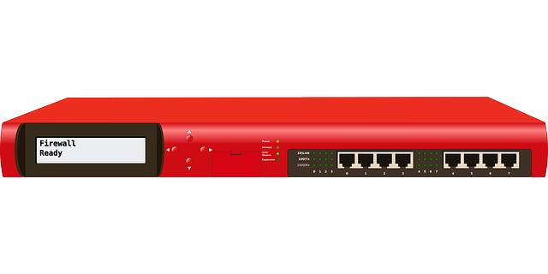

Network Security – Network Intrusion Detection System
Internet
Notes:
Passive Device

Slide 3


Network Security – Network Intrusion Prevention System
Internet
Notes:
Inline device

Slide 4
Network Security – Detection Methods
Type | Characteristics
Signature-based | Database of known hashes/signatures
Heuristics-based | Set of specific patterns
Behavior-based | Set of actions that match a threat’s behavior
Anomaly-based | Requires a baseline establishment, detects behavior against baseline

